Slide 1
EXECUTIVE SUMMARY

Slide 2
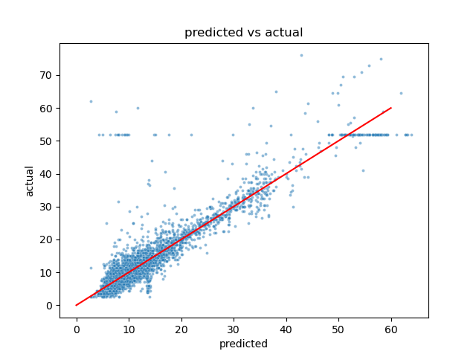
Regression Model for Fare Estimation
Content:
The Automatidata data team chose to create a multiple linear regression (MLR) model based on the type and distribution of data provided. The MLR model showed a successful model that estimates taxi cab fares prior to the ride.
Coefficients
Distance | Duration | RateCodeID | Rush Hour
6.93 | 2.96 | 0.94 | 0.14
Model Metrics
R2 | MAE | MSE | RMSE
0.84 | 2.16 | 17.82 | 4.22
Key Insights:
The feature with the greatest effect on fare amount was ride distance. The model revealed a mean increase of $7 for each additional mile, however, this is not a reliable benchmark due to high correlation between some features.
The model provides a generally strong and reliable fare prediction that can be used in downstream modeling efforts.
The New York City Taxi and Limousine commission can use these findings to create an app that allows users (TLC riders) to see the estimated fare before their ride begins.
The scatter plot shows a linear regression model plot illustrating predicted and actual fare amount for taxi cab rides.
2

Slide 3
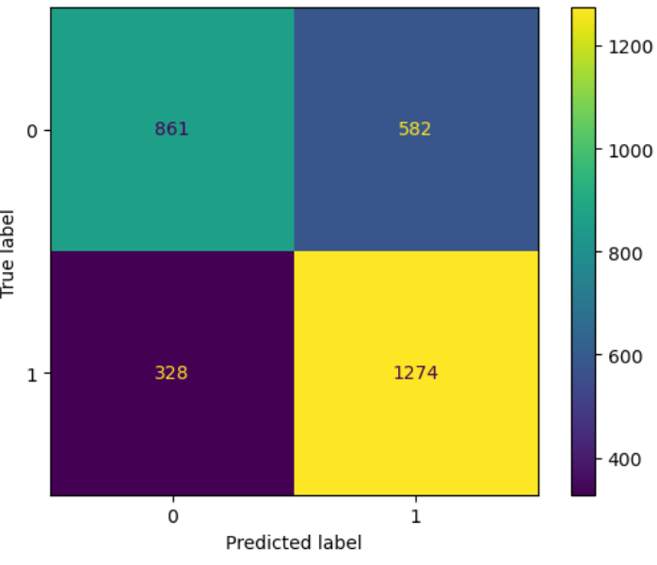
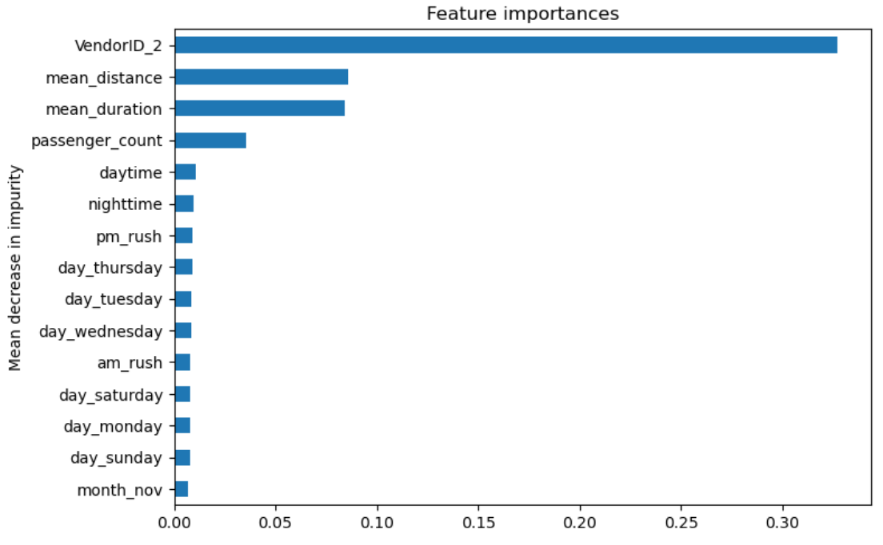
Tree Based Models for Tips Estimation
Content:
The Automatidata data team chose to create a Random Forest (RF) model based on the type and distribution of data provided. The RF model showed a model that predicts whether a rider will leave a generous tip (>20% total payment).
Key Insights:
Two models are trained and evaluated. Both showed similar scores during evaluation with 73% F1, 70% accuracy, 69% precision and 80% recall.
The scores indicate a model with decent performance, however it’s not idea for the intended purpose. The high false positive rate may upset the drivers when they expect a generous tip but do not receive one. .
It may also raise some ethical concern that drivers may decline service to those who won’t give generous tips and impact overall customer satisfaction.
Due to the concerns listed above, we suggest against integrating this model to future app development.
Model Metrics
model | precision | recall | F1 | accuracy
Random Forest | 0.686422 | 0.795256 | 0.736842 | 0.701149
XGBoost | 0.686858 | 0.792759 | 0.736019 | 0.700821
Confusion Matrix
Feature Importance Ranking

